Slide 1
TRABALL
Computer Graphics Term Project
201835437 김진경
201835492 이슬이
201835529 조시연

Slide 2
INDEX
Term Project PROPOSAL
Brief Description
Key features
Task Scheduling
Member info

Slide 3
BRIEF DESCRIPTION
Term Project PROPOSAL
Move the ball to the destination
TRAVEL + BALL
||
TRABALL
Move to the next level
within a set time to destination.
Play the game with the mouse.

Slide 4







BRIEF DESCRIPTION - DEMO
Term Project PROPOSAL

Slide 5



BRIEF DESCRIPTION - DEMO
Term Project PROPOSAL

Slide 6
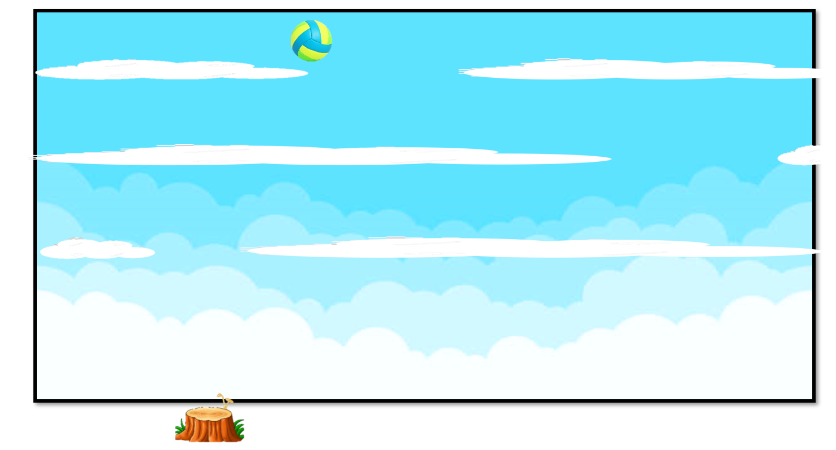


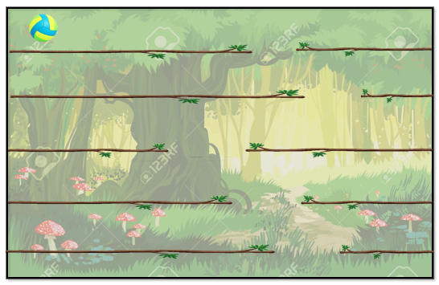
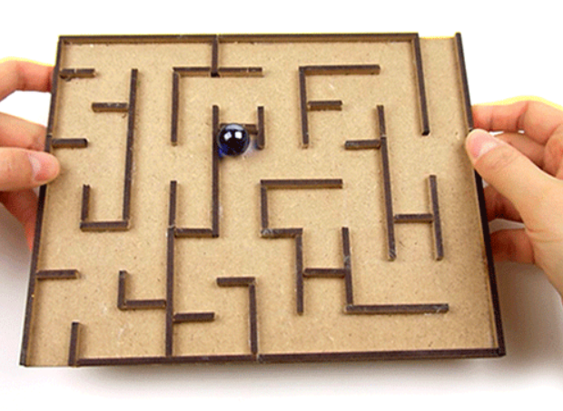
BRIEF DESCRIPTION
Term Project PROPOSAL

Slide 7

KEY FEATURES
Term Project PROPOSAL
The game will be implemented in 3D.
As the game level goes up,
the time limit becomes tight and traps appear.
The speed of the ball depends on the degree of movement of the mouse.

Slide 8
SCHEDULE
Term Project PROPOSAL
November, 2020
SUN | MON | TUE | WED | THR | FRI | SAT
1 | 2 | 3 | 4 | 5 | 6 | 7
8 | 9 | 10 | 11 | 12 | 13 | 14
15 | 16 | 17 | 18 | 19 | 20 | 21
22 | 23 | 24 | 25 | 26 | 27 | 28
29 | 30
Meeting
Map Design
Meeting
Event implementation
Meeting
3D & Texture
Meeting
Supplementation & WebXR & Final Presentation
Meeting

Slide 9



TEAM MEMBERS INFO.
Term Project PROPOSAL
201835437 김진경
201835492 이슬이
201835529 조시연
lx97@kakao.com
Proposal presentation
isueli713@gmail.com
Final presentation
chosiyeonn@gmail.com
Presentation production

Slide 10
Term Project PROPOSAL
Thank you

